Slide 1

Section 2.5 Continuity
Lecture 2
Growing complexity and the IVT

Slide 2
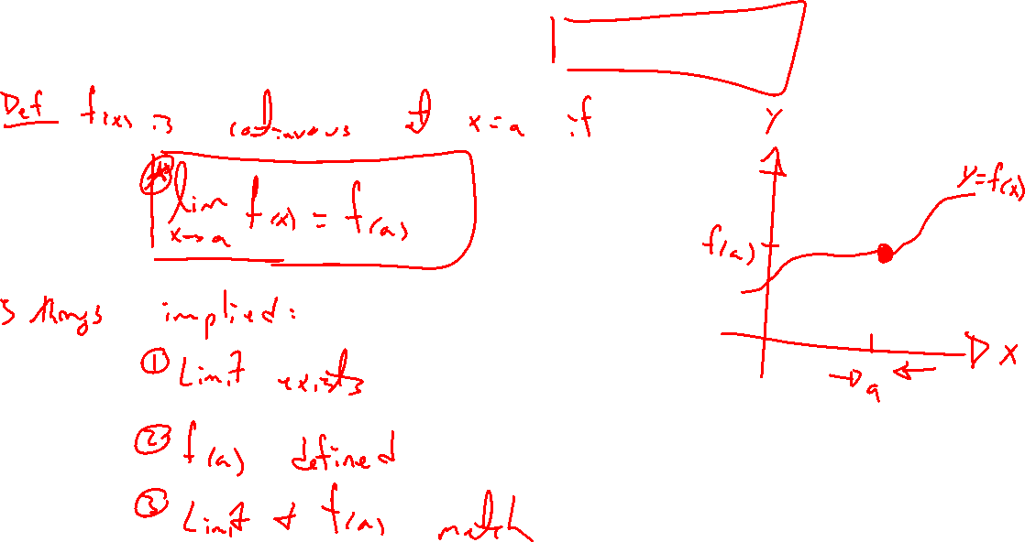
Recap: Limit definition of continuity
Notes:
Says three things, draw picture.

Slide 3
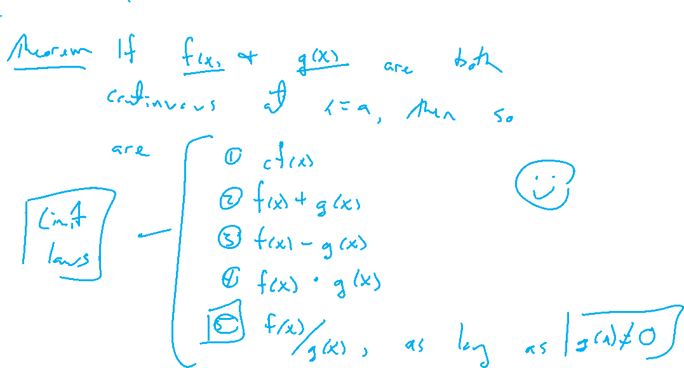
Combinations of continuous functions
Notes:
Cf(x), +,-, x, /
Note, these are just the 5 limit laws.

Slide 4
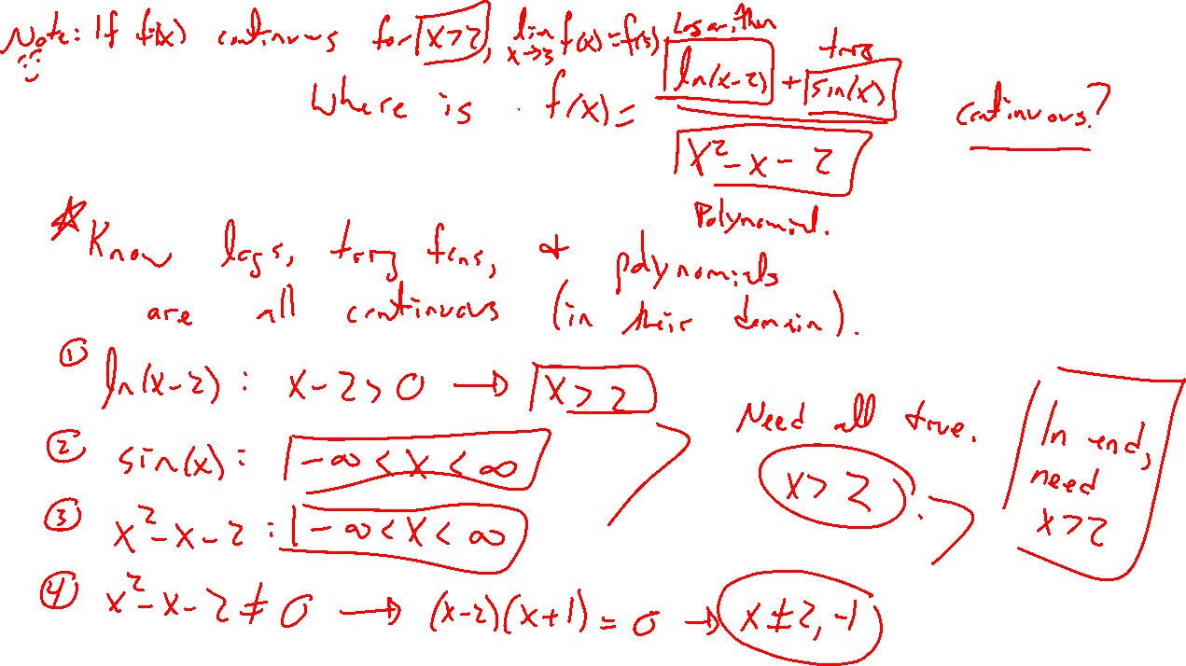
Example:
Notes:
Where is f continuous?
F(x) = (ln(x-2) + sin(x))/(x^2-x-2)
Check where each is continuous, watch for zero division

Slide 5
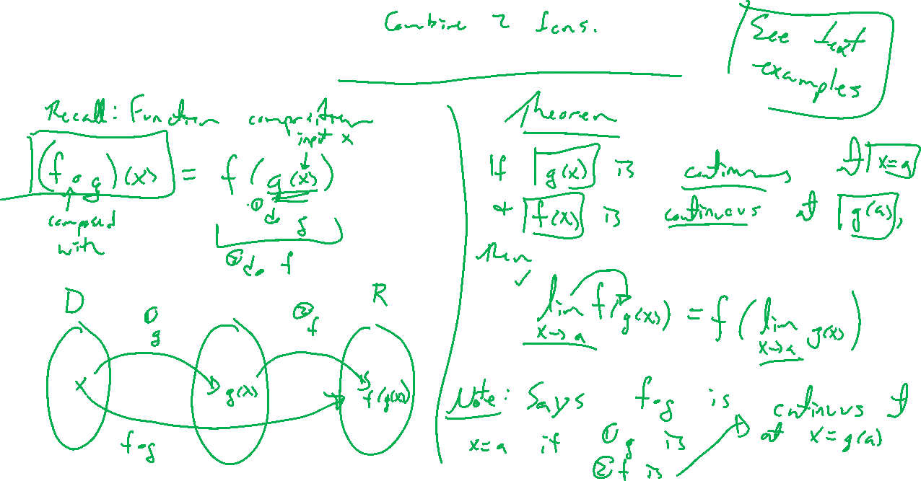
Continuity and function composition
Notes:
Remind function composition.
Can pass limit to the inside.
Note, this implies continuity for the compositoin of two cont functions
Straightforward result, examples in HW.

Slide 6
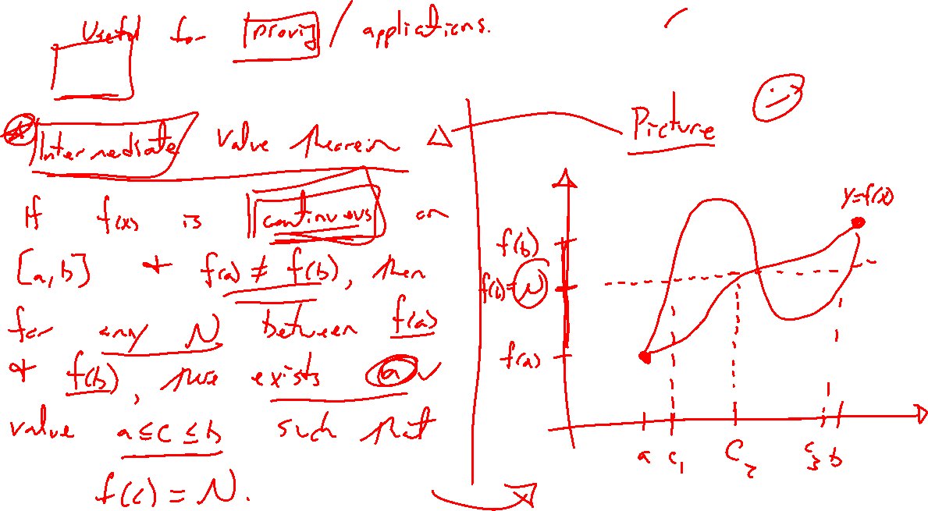
IVT: Continuity applied
Notes:
Interm value theorem. Draw picture of continuous function.
Statement: For f continuous on [a,b] with f(a) \neq f(b).
For any number L between f(a) and f(b), there exists an N such that f(c)=N for a<c<b.
Seem obvious. Useful when you don't have a good handle on f.
Named theorem means important. Know this result since shows up in surprising places.

Slide 7
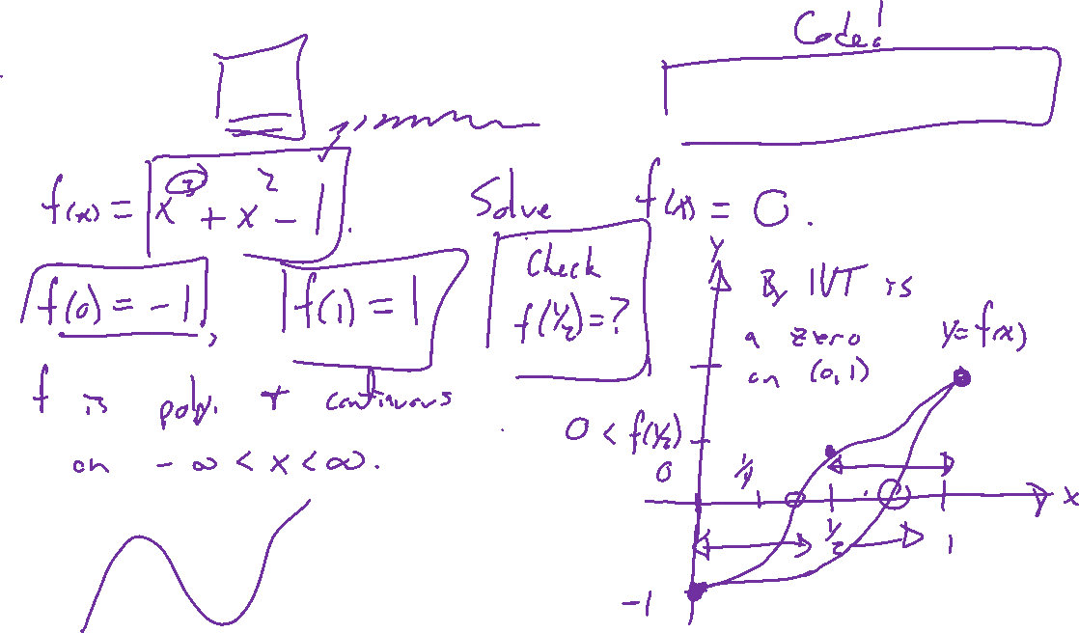
Example: IVT, root finding, and bisection method
Notes:
F(x) = x^3+x^2-1 has a root on [0,1].
Picture to explain why. How to approximate?
Bisection demo in Excel

Slide 8
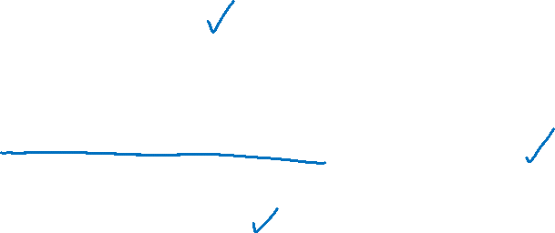
Section 2.5: Textbook Examples and Exercises
Rework examples 1, 2, 4, 5, 6, 7, 9, 10 in the text. Steps:
Write down a problem.
Close the book and attempt on own.
Check / correct your solution against the text solution.
If needed, rewrite the problem to be of the quality of the text solution.
Complete exercises 3, 11, 23, 25, 35, 43, 53
Write solutions of the same quality as in lecture and text solutions.
Check your solution against the answer in the back of the book.
Video reflection
None

Slide 9

Homework Submission to Canvas
Preview of section
Skim the section in text and write a short paragraph summary.
Give a bulleted list of all important definitions, theorems, and formulas without details.
Notes on video lectures
Take notes on everything written on slides including all details, worked examples, on-own activities, as well as your own thoughts and questions.
Try on-own activities first, then write down provided solution next to it for comparison.
Worked examples from the text
Write down the problem and attempt without looking at the solution.
Use the solution to write the best explanation you can.
Solutions to textbook exercises
Model approaches and explanations given in the video lectures and textbook examples.
Final reflection of section
List the key takeaways to remember as a bulleted list.
Video reflection (for some sections)
Write a 1 paragraph reflection on the video discussing what you found most interesting or useful.
Notes:
Mention graded for completion and quality of writing.

